Slide 1
Sudoku Solver
Part 4 (Final)

Slide 2
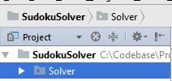
What you have so far
Project: Sudoku Solver
Python Package: Solver
Class: Cell.py (An object that represents a cell on the Sudoku Board)
Template link: template_cell.py
Completed link: Cell.py
Class: GUI.py (Controls the graphical user interface)
Completed link: GUI.py
Class: SudokuBoard.py (An object representing the Sudoku Board)
Template link: temp_sudokuboard.py
Completed link: SudokuBoard.py

Slide 3
What’s left…
In class SudokuBoard:
Solver Method
Validation Method
Find Possible Numbers Method
Create class run.py to combine the SudokuBoard and the GUI

Slide 4
Find Possible Numbers Method
Given a Cell object, find all the possible numbers that could exist in that cell.
To do this, we need to go through the cell’s column, row, and box and make sure that none of the numbers existing in them are given back as a possible number.
I.E., we are going to start with a SET of all valid sudoku numbers (1-9), and then loop through the given Cell’s column, row, and box, and as we find numbers existing in those we will add them to a different SET of existing numbers. Then we will use set difference (math) on the valid set and the existing numbers set to get our possible numbers. We will then use the cell object’s method set_possible_numbers to set that cells possible numbers.

Slide 5
Find Possible Numbers Algorithm
Store the cell’s row number in a variable and column number in a variable
Initialize a set of valid numbers (1-9)
Initialize an empty set of existing numbers
Loop through the row and column of the cell and add each number to the existing numbers set
Loop through the cell’s box and add each number found to the existing numbers set (I will provide Orion’s way to do this… it is complicated)
Perform set difference on the valid and existing numbers and set the cells numbers to the result

Slide 6
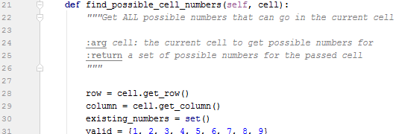
Finding Possible numbers
Line 1 is the method signature, specifying the name of the method and its parameters
Line 28 is where we are storing the cell’s row number
Line 29 is where we store the cell’s column number
Line 30 is where we initialize an empty set to hold all the existing numbers we find
Line 31 is where we initialize a set of all possible valid numbers on our sudoku board

Slide 7

Finding Possible numbers
Line 33 is the beginning of a FOR loop that will assign the variable x to numbers 0 – 8.
Line 35 adds all of the numbers we find in the cell’s column to our existing numbers set
Line 36 adds all of the numbers we find in the cell’s row to our existing numbers set

Slide 8

Finding Possible Numbers
This is where things get messy. Thanks to Orion for taking care of this for us.
Line 40 is the beginning of a FOR loop that loops through each row in the box of our cell
Line 41 is the beginning of a nested FOR loop that loops through each column in the box of our cell
Line 42 adds the number we find at the cell to our existing numbers set

Slide 9

Finding Possible Numbers
Now all that is left is to find our possible numbers and set the cell’s possible numbers equal to them.
We use set difference to calculate all of the numbers that don’t exist in our cell’s row, column, or box. ‘valid’ contains the numbers 1-9, and our existing numbers has all of the numbers found in our cell’s row, column, and box. Subtracting these two will give us the possible numbers.
Then we use the method ‘set_possible_numbers()’ of our cell object to set its possible numbers

Slide 10
Validating the Sudoku Board
Now we need a method to check if the sudoku board is a valid sudoku board.
This method will be similar to the find_possible_cell_numbers() method, because we will be looping through the Sudoku board and checking each row, column, and box for invalid number placement.
The difference is we will loop through the ENTIRE board instead of just the row/col/box pertaining to a certain cell.

Slide 11
Validating the Sudoku Board algorithm
Initialize 3 empty LISTS for row, column, and box numbers (so we can keep track of what we find)
For each row, column in the board, add the non-zero numbers found to their respective list. At the end of each row check for duplicate numbers in each list, if duplicates exist return False.
For each row, column for the numbers 0, 3, 6, find all the numbers in the box at that position on the board. (This is messy again). At the end of each box, check for duplicate numbers in the box list. If duplicates exist return False.
Return True

Slide 12

Validating the Sudoku Board algorithm
Line 48 is where we write our method signature, defining the method name and any parameters passed to it.
Line 50-52 is where we initialize empty lists for row, column, and box to keep track of numbers we have seen

Slide 13
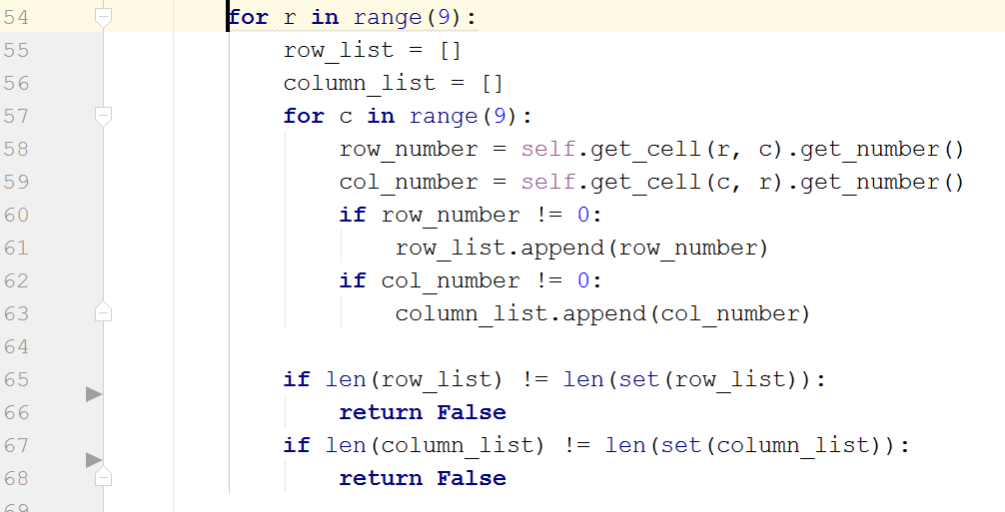
Validating the Sudoku Board algorithm
Line 54 is our initial for loop to go through all of the rows in our board
Line 55 and 56 reset our row and column list (so we don’t have the previously cheked row and column numbers in there)
Line 58-59 get the respective number in the column and row (notice the [r][c] and [c][r] switch)
Line 60-66 add the non zero number to its respective list
Lines 65-68 are outside of the second FOR loop but inside the first, and check if each list is of equal length to it’s respective set. This will tell if there are any duplicates (because sets have unique numbers only)

Slide 14
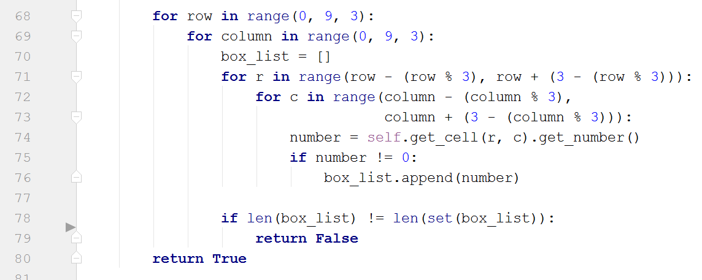
Validating the Sudoku Board algorithm
Line 68 and 69 are FOR loops that loop through the board IN STEPS OF 3! Meaning index 0, 3, 6 and that’s it.
Line 70 re-sets the box_list (so we don’t have the previously checked box numbers in there twice)
Lines 71-72 are the complicated loops to get the numbers in the box only
Lines 78-79 check for duplicates in the box by the same method as previously
Line 79 is outside of all loops and at the bottom of our method, returns True (meaning no violations were found and the board is valid)

Slide 15
Solving the Sudoku Board
Last method, a method to attempt to solve the Sudoku Board.
We will first use validate_board() to check to see if the board is a valid one
We will loop through each cell on the board and attempt to place a valid number in it. If there is no valid number to be placed, we will go back to the previous cell and try a different number.

Slide 16
Solve algorithm
Check if board is valid
Loop through entire board cell be cell, and if the cell does not have a number
If the cell does not have possible numbers then find them
If the cell has possible numbers then try and put a number in the cell, add the cell to a list of cell’s we have tried, and move to the next cell
Else if the list of cells we have tried is not empty, reset the current cell, get the previous cell we tried from the cells tried list and backtrack to it, then remove it from the cells tried list and set the loop back to its position (to attempt a new number)
Otherwise the board is unsolvable, return false
Return true

Slide 17
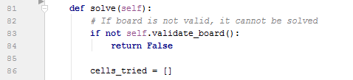
Solve
Line 81 is our method signature
Line 83-84 is where we check to see if the board is a valid board
Line 86 is where we initialize an empty list to hold all the cell’s we try to put a number in

Slide 18
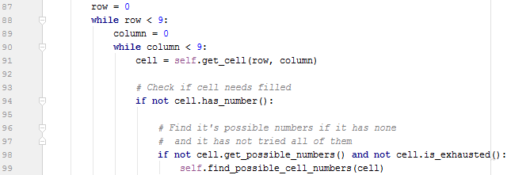
Solve
Line 87 – 90 is where we initialize 2 WHILE loops to loop through each cell in our board. We need while loops instead of for loops because we don’t know how many times we will have to visit each cell (due to backtracking).
Line 91 is where we get the cell at our loop position
Line 94 is where we check if the cell has a number
Line 98-99 is where we get the cells possible numbers if it doesn’t have any, and if it isn’t exhausted (i.e., not all possible numbers have been tried)

Slide 19
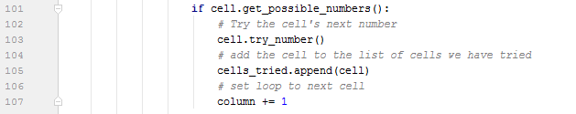
Solve
Line 101 is the nested conditional that checks if the cell has possible numbers
Line 103 tells the cell to try the next number it has
Line 105 adds the current cell to the cells_tried list
Line 107 moves the loop to the next cell

Slide 20
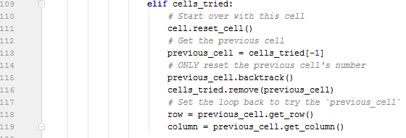
Solve
Line 109 is where we check if we have tried any cells
Line 111 is where we reset the current cell we are on
Line 113 is where we get the previous cell we put a number in from our cells tried list
Line 115 is where we backtrack on the previous cell
Line 116 is where we remove the previous cell from the cells tried list (because we are going to try it again)
Line 118 and 119 are where we set the loop back to the previous cell

Slide 21
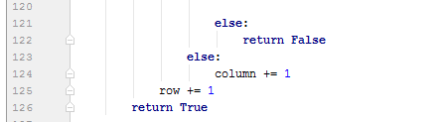
Solve
Line 121-122 is where if none of the above worked, we return False because the board must be unsolvable
Line 123-125 is where we advance our loop
Line 126 is where we return True, we are outside and done with the loop meaning all cells have numbers in them (and hopefully valid ones)

Slide 22
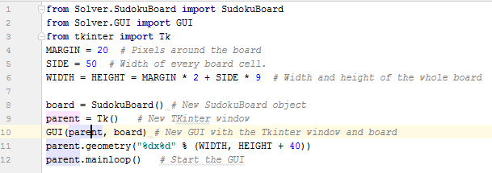
Run.py
This file brings all the objects together and coordinates them to produce the final program. It is pretty simple and is really just setting it up, so I will just give it to you, copy/paste it in a new python file ‘run.py’:

Slide 23
Done
You should now be able to right-click on ‘run.py’ and click “Run”, and the GUI should pop up. If you press ‘Solve’ button immediately it should solve the blank sudoku board.
You can enter numbers by clicking on the cells in the board and pressing numbers 1-9 on your keyboard,
You can move cells using the arrow keys (or by mouse, or entering numbers)
NOTE* you may have to adjust two lines of code in GUI.py if the arrow keys do not work, I am not sure if the key events are the same on mac as they are on windows.

Slide 24
Debugging
IF when you run the ‘run.py’ file you get errors, or when you press ‘Solve’ you get errors, PAY ATTENTION TO THEM! They can help you fix what you need to fix!
Usually the error is a small typo, or a miss-indent, or a small syntax error (missing colon, missing parenthesis, etc.)
If you need to, you can insert ‘print(‘print something here’)’ statements where you think the error in your code is, and try to figure it out from there
If you still cant get it, feel free to email me at dane.r.lowrey@ttu.edu.
The entire project solution can be found here on my github

